Slide 1
INTERNET OF THINGS

Slide 2
Smart Refrigerator

Slide 3
Problem Identification
Limited Temperature Control: The temperature control system is based solely on analog temperature readings without precise control mechanisms.
Inefficient Energy Usage: The fan speed control lacks sophistication and may lead to unnecessary energy consumption.

Slide 4
Problem Statement
A user friendly mini fridge which self-regulates the temperature.
Also integrated power saving based on the inventory of the products (water bottles) inside.

Slide 5
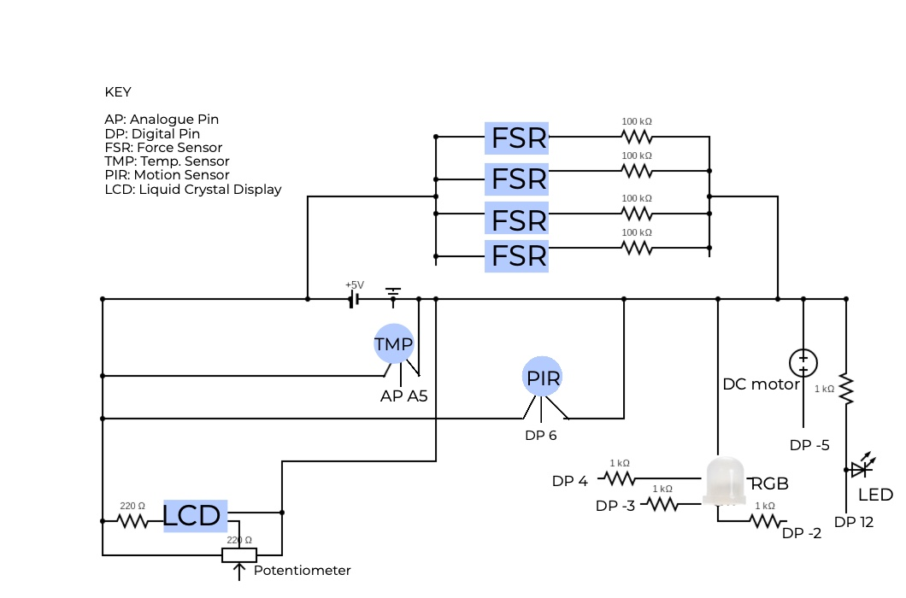
Block Diagram

Slide 6
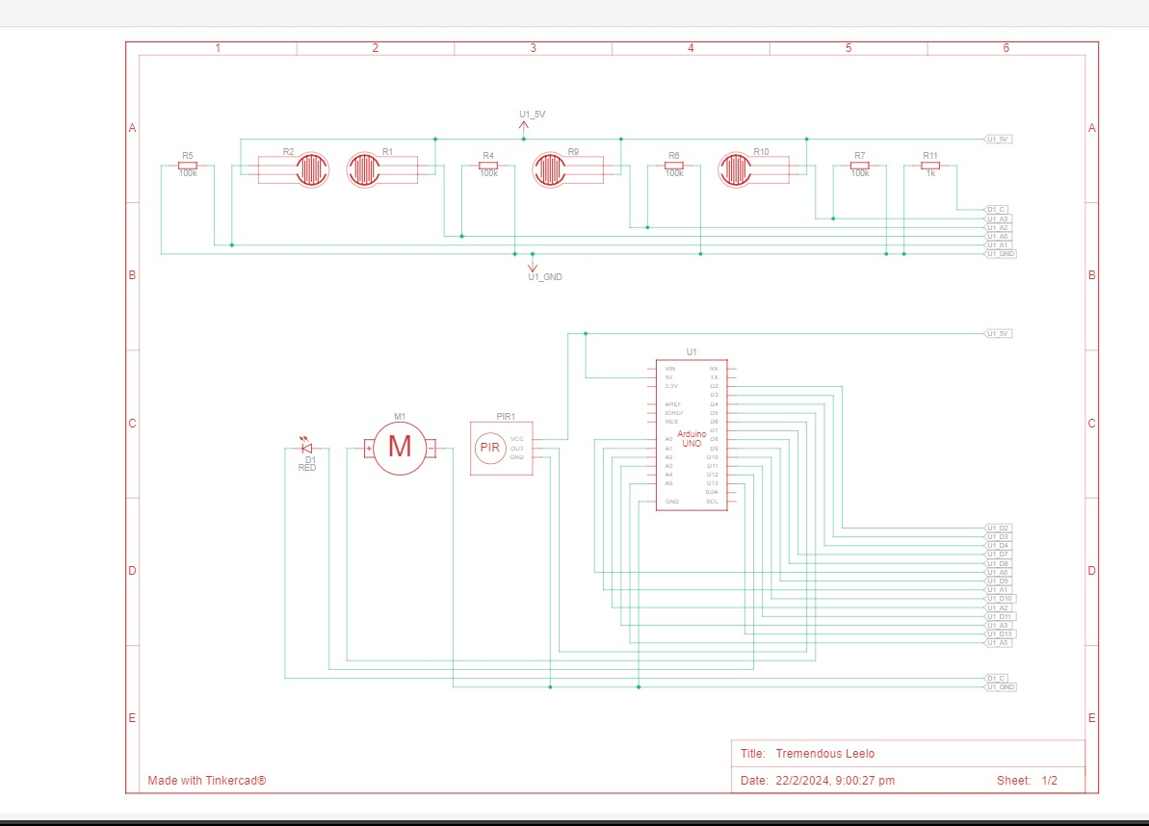
Schemantic Diagram

Slide 7
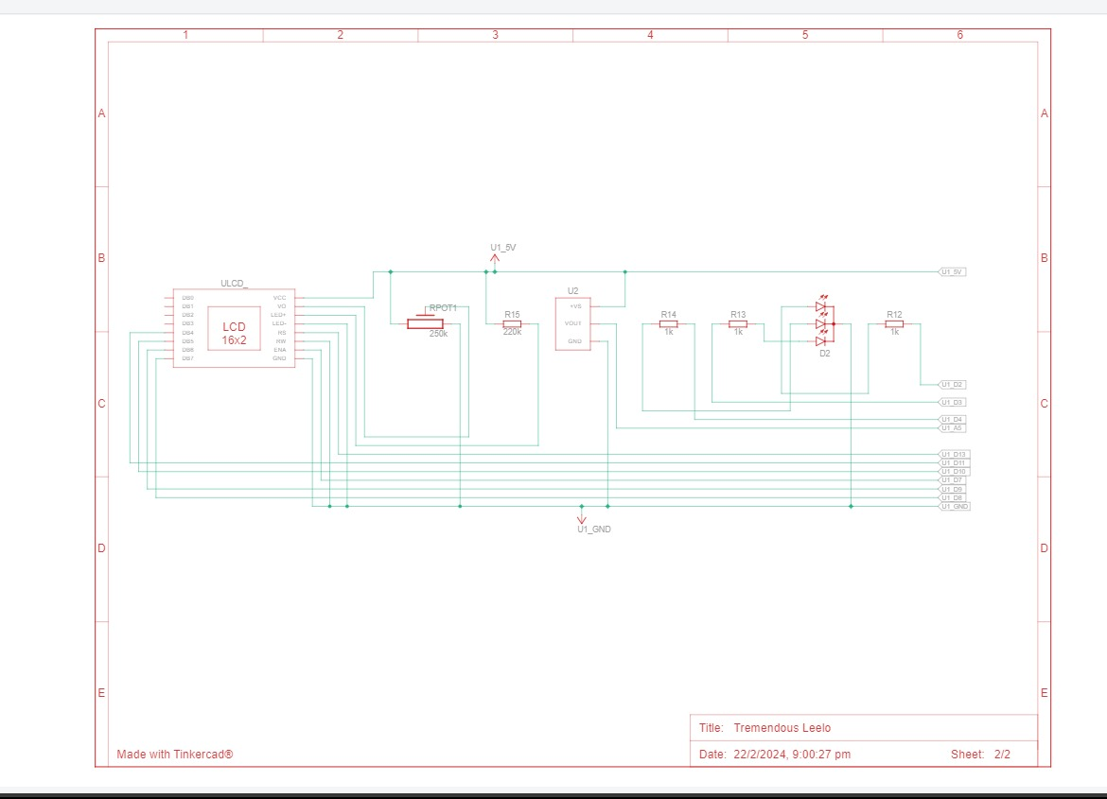

Slide 8
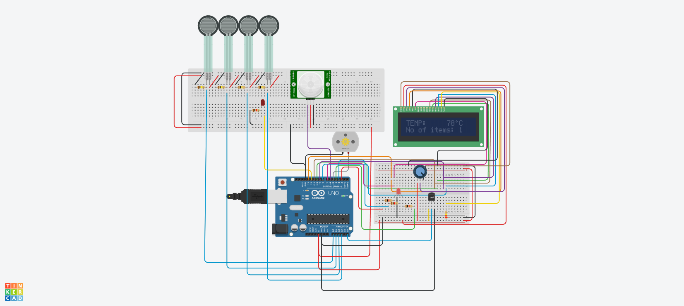
Working Model

Slide 9
Thank You

